Slide 1


Airplane Crash Analysis
Presented By Nagendra V Kini

Slide 2
OBJEC TIVE OF THIS ANALYSIS
The objective of an airplane crash analysis presentation is to delve into the causes of crashes, improve safety measures, inform stakeholders about investigation findings, highlight prevention strategies, and raise awareness about the importance of continuous improvement in aviation safety.
Certainly! The presentation aims to dissect the intricate factors behind airplane crashes, offering insights to enhance safety protocols, educate stakeholders, and advocate for proactive measures to prevent future incidents.
Tools Used to Analyze This Project :- Tableau

Slide 3
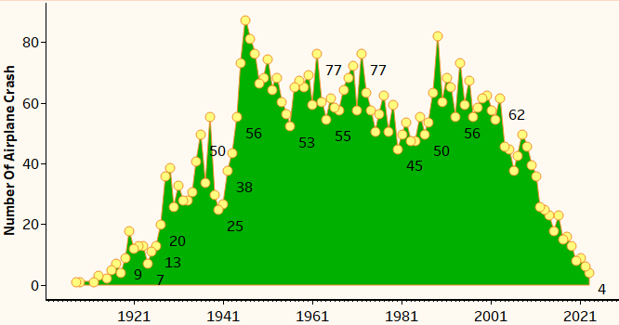
CHART
INSIGHT
Airplane Crashes Over The Years
Utilizing Tableau, we conducted a comprehensive examination of airplane crashes across various years, unveiling compelling insights. For instance, our data revealed a notable observation: in 1946, the frequency of airplane crashes surged to 88 incidents. This revelation underscores the significance of our analysis in deciphering historical trends and informing future aviation safety measures.

Slide 4
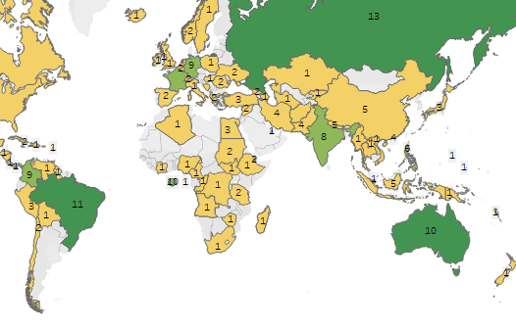
CHART
INSIGHT
Airplane Crashes Locations On Map
During our meticulous analysis of airplane crashes using Tableau, we discovered significant insights regarding crash locations. Russia emerged as a prominent contributor with 13 recorded crashes, closely followed by Brazil with 11 incidents, Australia with 10 incidents. Germany and France, colombia also made substantial contributions each accounting for 9 crashes. This geographic distribution sheds light on areas of heightened aviation risk, prompting a closer examination of safety protocols and prevention strategies in these regions.

Slide 5
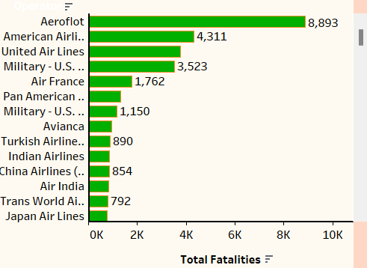
CHART
INSIGHT
Operator With Highest Number Of Incidents
In our comprehensive airplane crash analysis conducted with Tableau, we scrutinized operators with higher incidence rates. Notably, Aeroflot stood out with the highest number of incidents, resulting in a total of 8,893 fatalities. Following closely behind were American Airlines, which recorded 4,311 fatalities, and United Airlines with 3,772 fatalities. Additionally, the U.S. Air Force's military operations reported 3,523 fatalities. These findings underscore the importance of examining operator performance and implementing robust safety measures to mitigate risks and prevent future tragedies.

Slide 6
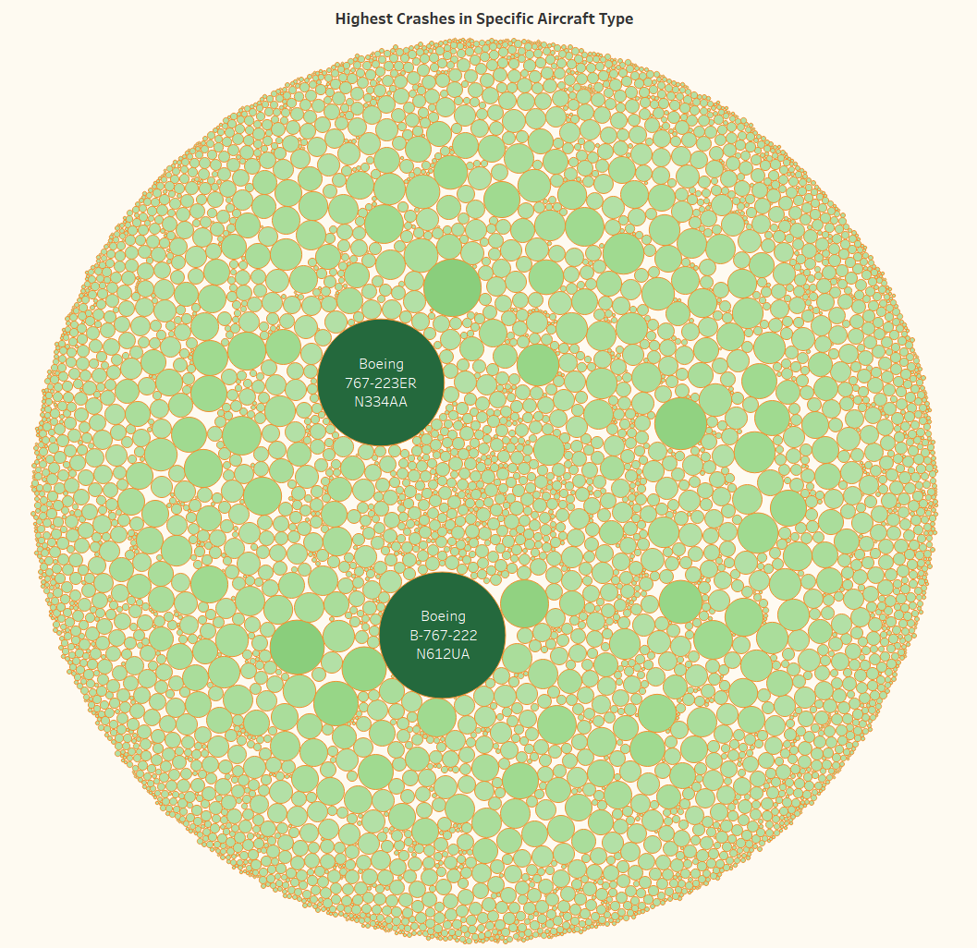
CHART
INSIGHT
Highest Crashes in Specific Aircraft Type
Our analysis of airplane crashes, powered by Tableau, unearthed compelling insights regarding the most frequent occurrences by aircraft type. Notably, the Boeing 767-223ER, registered as N334AA, emerged with the highest fatality count, totaling 2842. Following closely behind is the Boeing B-767-222, registered as N612UA, with a total fatality count of 2815. These findings shed light on critical safety considerations within the aviation industry.

Slide 7
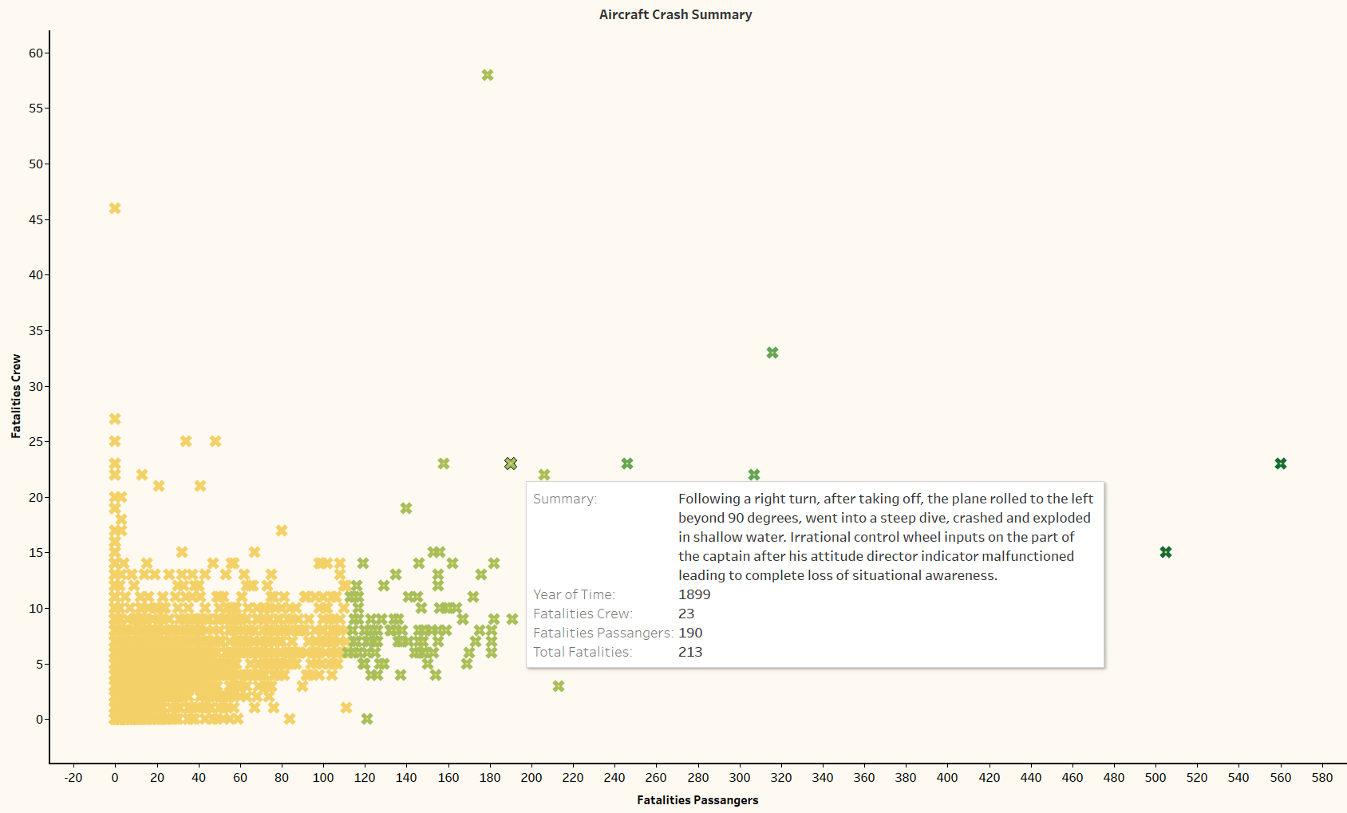
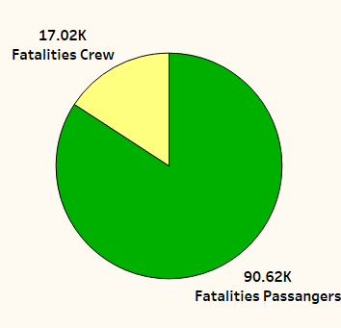
CHART
INSIGHT
Fatality Trends And Airplane Crash Summary
We conducted an in-depth analysis of airplane crashes using Tableau. Our findings revealed significant insights: the total number of fatalities, the overall fatality rate, and specific figures for crew and passenger fatalities. Among the data, one striking discovery was an incident with the highest recorded fatality count for crew members, totaling 58, and 179 for passengers, resulting in an overall fatality count of 691. Unfortunately, the year and summary for this tragic event remain unknown.Additionally, we uncovered an incident dating back to 1899, where the highest number of passengers lost their lives, totaling 560. In this case, 23 crew members also perished, bringing the total fatality count to 583. This incident stands as a stark reminder of the risks involved in air travel.

Slide 8
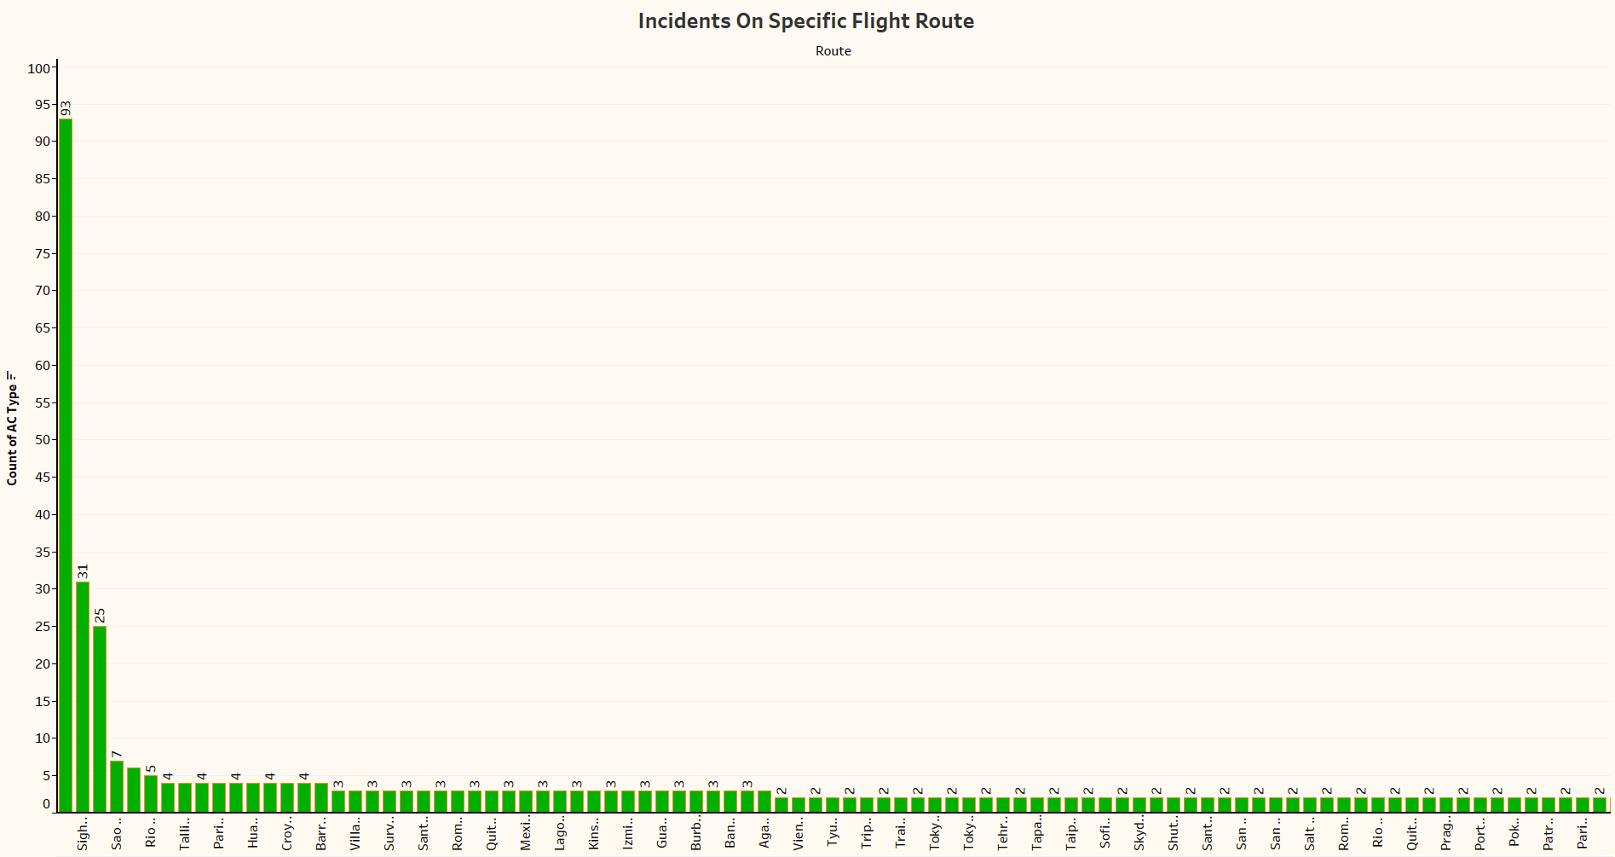
CHART
INSIGHT
Fatality Trends And Airplane Crash Summary
During our comprehensive analysis of airplane crashes, we discovered distinct patterns in incidents occurring on specific flight routes. Surprisingly, the route designated for training flights stood out with the highest number of accidents, involving 93 individuals. In contrast, sightseeing routes experienced 31 accidents, while the Sao Paulo to Rio de Janeiro route recorded 7 accidents. These findings underscore the importance of route safety protocols in mitigating aviation risks.

Slide 9
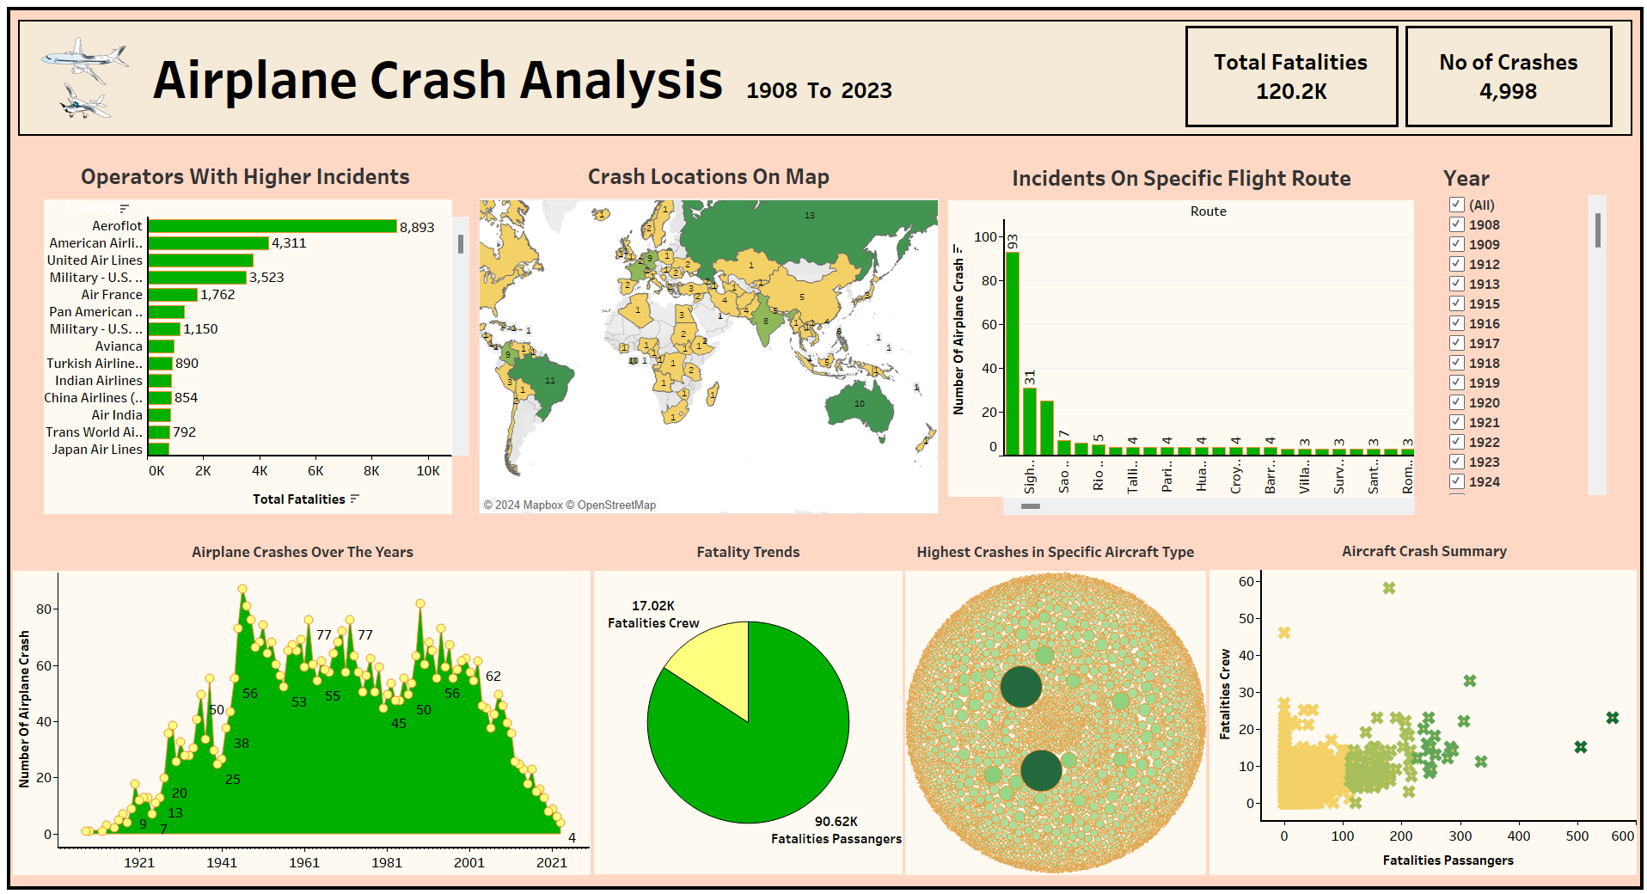
DASHBOARD

Slide 10
Recommendation
Based on the insights derived from our Tableau analysis of airplane crashes, the following recommended actions can be implemented to improve the aviation sector:
Historical Trend Analysis and Proactive Measures :
Establish a dedicated task force to conduct further analysis on the surge in airplane crashes observed in 1946. Identify the underlying causes and trends driving this increase, and develop proactive measures and strategies to prevent similar occurrences in the future. This could involve enhanced pilot training, aircraft maintenance protocols, and regulatory oversight.
2. Geospatial Risk Assessment and Regional Safety Enhancements :
Collaborate with aviation authorities in high-risk regions such as Russia, Brazil, Australia, Germany, France, and Colombia to conduct comprehensive safety assessments. Implement targeted safety protocols and prevention strategies tailored to the unique challenges of each region. This could include improved air traffic control systems, runway infrastructure upgrades, and enhanced emergency response capabilities.
3. Operator Performance Evaluation and Safety Improvement Initiatives :
Engage with airline operators identified with higher incidence rates, such as Aeroflot, American Airlines, United Airlines, and the U.S. Air Force, to conduct detailed safety audits. Work closely with these operators to identify areas for improvement in operational procedures, pilot training, and fleet maintenance. Implement robust safety management systems and performance monitoring mechanisms to mitigate risks and prevent future tragedies.

Slide 11
Recommendation
4. Aircraft Safety Enhancement and Regulatory Compliance :
Collaborate with aircraft manufacturers to enhance the safety features of aircraft types identified with the highest fatality counts, such as the Boeing 767-223ER and the Boeing B-767-222. Ensure rigorous compliance with safety regulations and standards, and implement mandatory safety upgrades where necessary. Conduct regular safety inspections and audits to ensure the continued airworthiness of the fleet.
5. Route Safety Optimization and Protocol Implementation :
Work closely with aviation authorities to optimize route safety protocols, particularly for routes with high accident frequencies like training flights and sightseeing routes. Implement enhanced route planning algorithms, airspace management systems, and pilot training programs focused on route-specific challenges. Strengthen collaboration between airlines, air traffic control agencies, and regulatory bodies to ensure effective risk mitigation measures are in place.
By implementing these recommended actions based on the insights derived from our Tableau analysis, the aviation sector can significantly enhance safety standards, reduce the frequency of airplane crashes, and safeguard the lives of passengers and crew members.

Slide 12
THANK YOU

